Slide 1
We Declare Independence!

Slide 2
The setting for our dramatization takes place in
the halls of the 2nd Continental Congress of 1776.
The voices we hear are among the 56 delegates
of the 13 original colonies.
Notable among these delegates were
John Adams, Roger Sherman, Robert R. Livingston,
Thomas Jefferson, Benjamin Franklin, John Hancock,
Patrick Henry, George Washington,
and Richard Henry Lee.

Slide 3
We hear not only the words of the day, but the developing sentiments that were to follow in the
Bill of Rights and the Constitution.
It should be noted that the Declaration of Independence and the subsequent Bill of Rights
and Constitution did not, at the times of their individual creation, support nor declare freedom,
nor guaranteed rights for all people
who lived in the land of America.

Slide 4
But as living documents, the Bill of Rights and the Constitution were destined to be adaptable to the growth of understanding in a society that dared claim itself to be
FREE

Slide 5
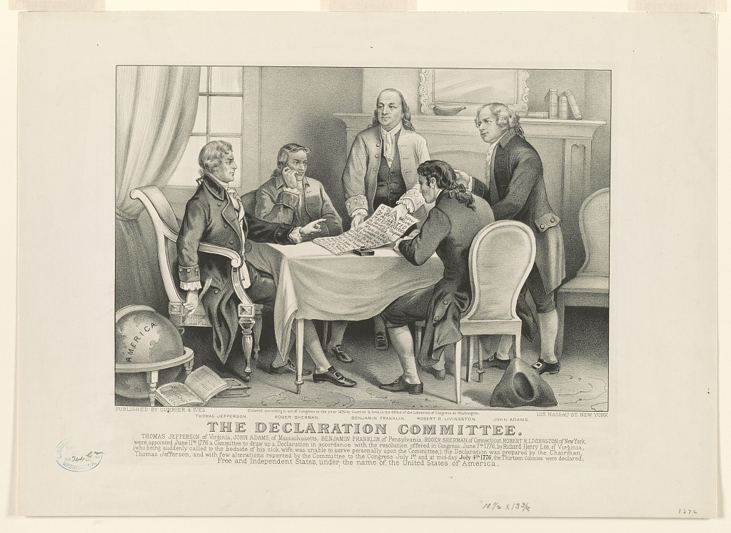

Slide 6
WE THE PEOPLE

Slide 7
...Should not be ruled by a king...
That taxation without representation
is unacceptable. Rather, we gather in this
2nd Continental Congress to assert
our independence from this,
or any tyrannical king or power...
That in our lives and in this land...
we will have liberty!

Slide 8
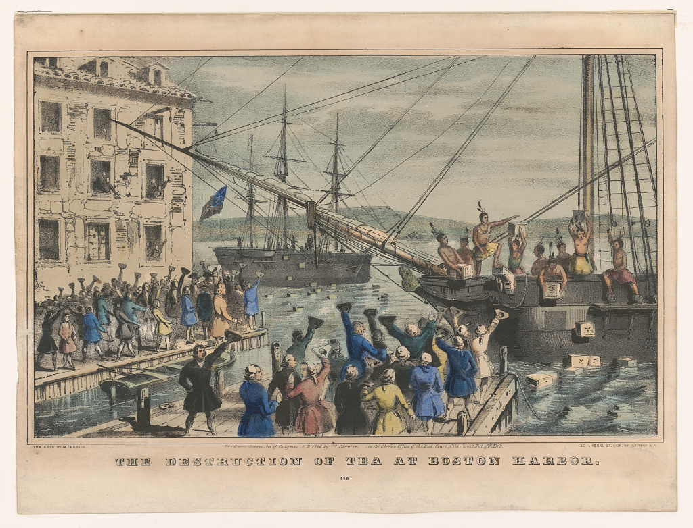

Slide 9
DECLARE IT TO YOU...

Slide 10
That with liberty, we will create laws
to govern the people and elect
representatives whose power can be given
or taken by the consent of the governed.
(The RIGHT TO VOTE)

Slide 11
Said representatives will use their power of persuasive speech rather than the threat
of violence to find consensus in matters
of legislation for the governed.

Slide 12
Said representatives will vote to uphold
the will of the people while sustaining,
supporting, and defending the
constitutional laws of the land...
thus the individual will be treated fairly
and there will be liberty and justice
for all citizens.

Slide 14
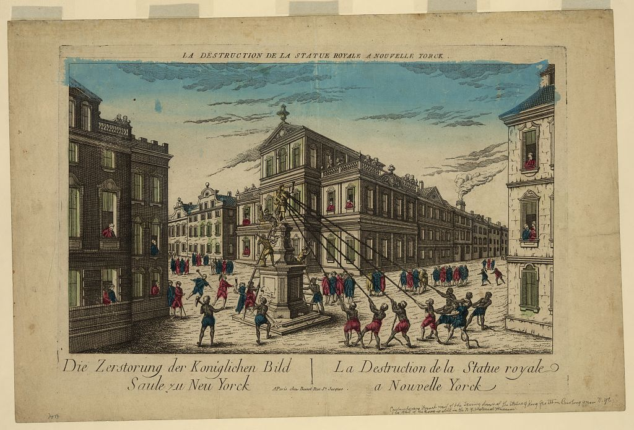
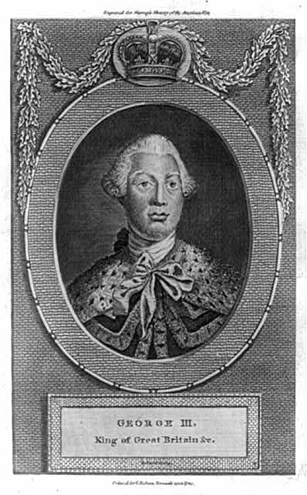
That
FREEDOM FROM TYRANNY...

Slide 15
...Is an ideal which unites us in purpose.
Indeed, we are intent upon
forming a government
of the people,
by the people, and
for the people.

Slide 16
A government that will have the rule of law
and the necessary checks and balances
of the Judiciary, Legislative, and Executive
branches of government in place,
that no individual or group
can usurp the powers of government
for their own gain.

Slide 17
Thus, the pursuits of happiness
of, by, and for the people –
will be within the bounds of the rule of law.

Slide 18
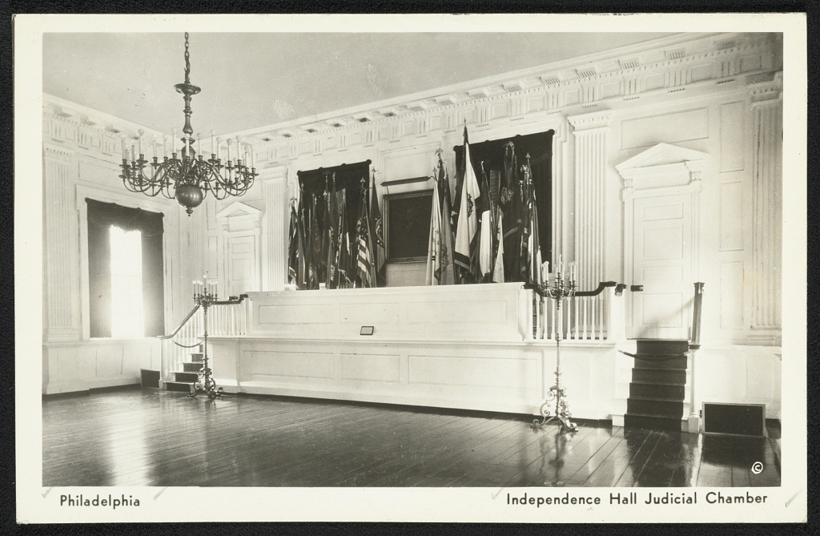

Slide 19
Say...
WE THE PEOPLE!

Slide 20
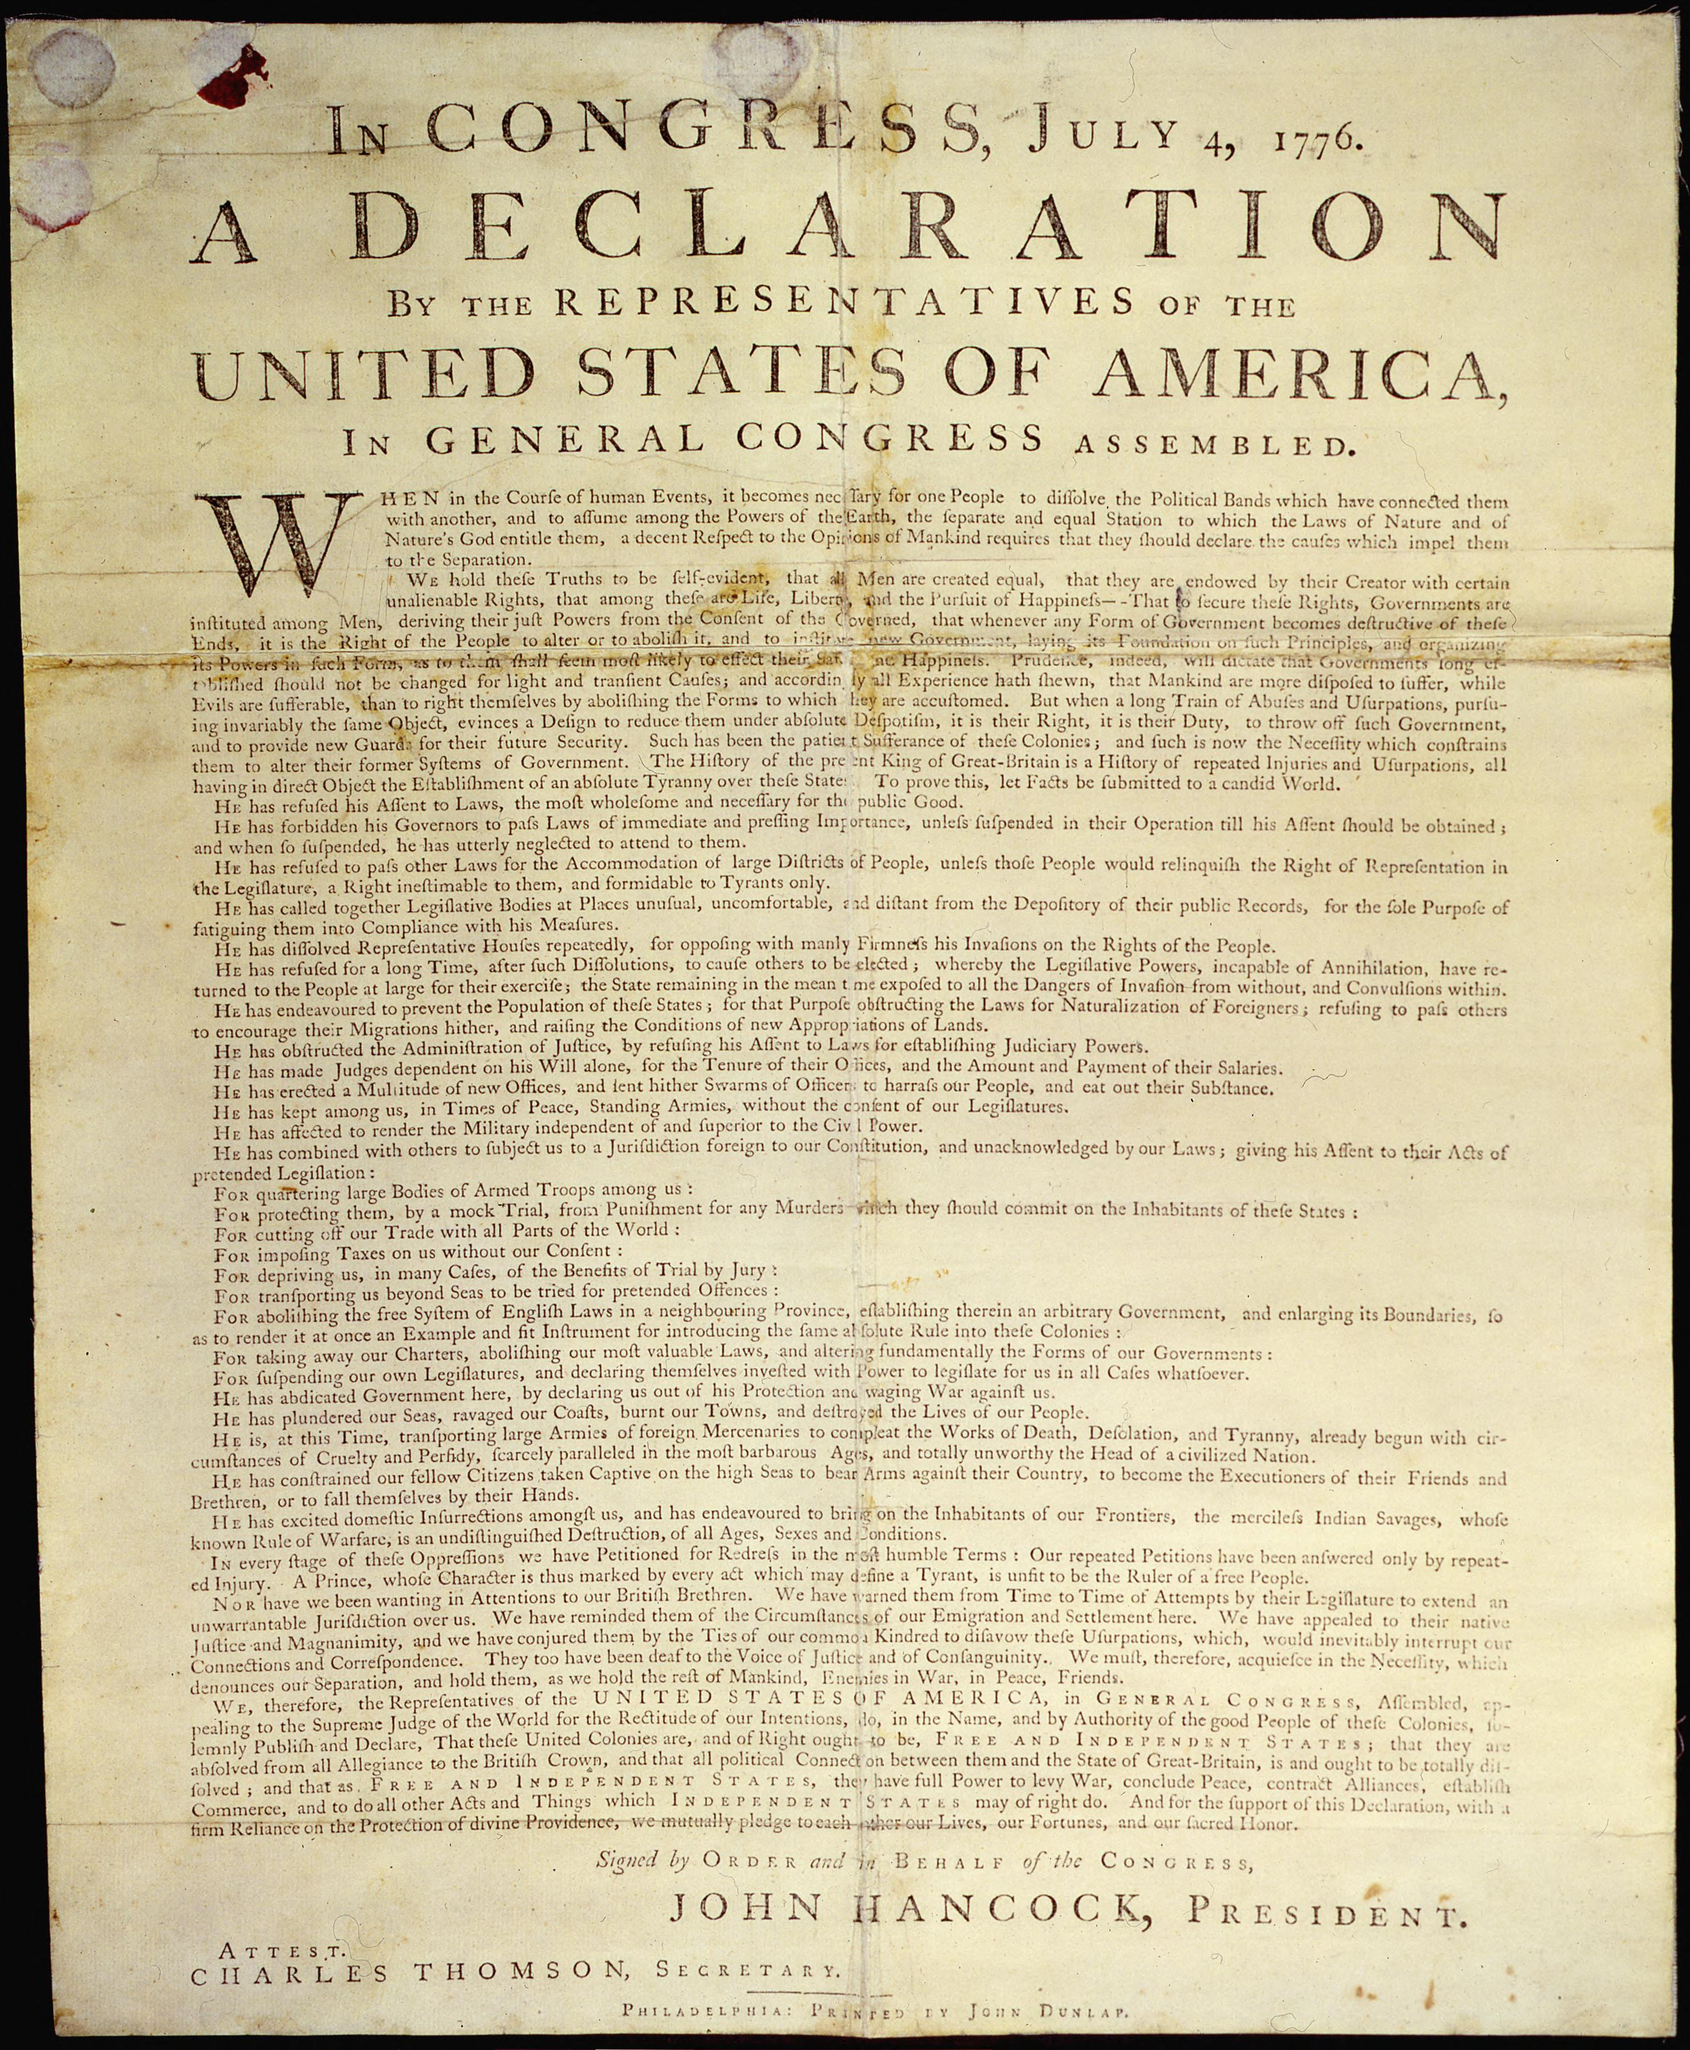
Though we have desired peace...yea, even
petitioned for it... it is now, with
unanimous voice, that we do solemnly
publish this Declaration of Independence

Slide 21
Not only to justify our rebellion against tyranny,
but do hereby also declare it to be
self-evident that we have unalienable,
natural rights...

Slide 22
...and that our government will function
to uphold and safe-guard those rights
in these United States of America!

Slide 23
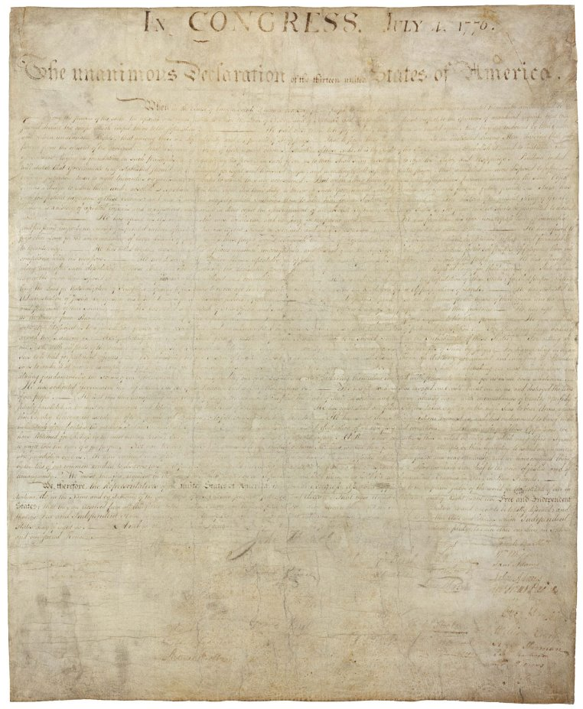

Slide 25
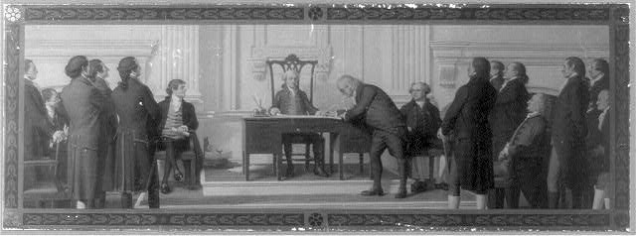
Alright everyone... Everyone! The quills are ready...
All of you gather at the table and sign...HERE...
(45 Delegates signed on July 4th,
the remainder by August 2nd, 1776)

Slide 26
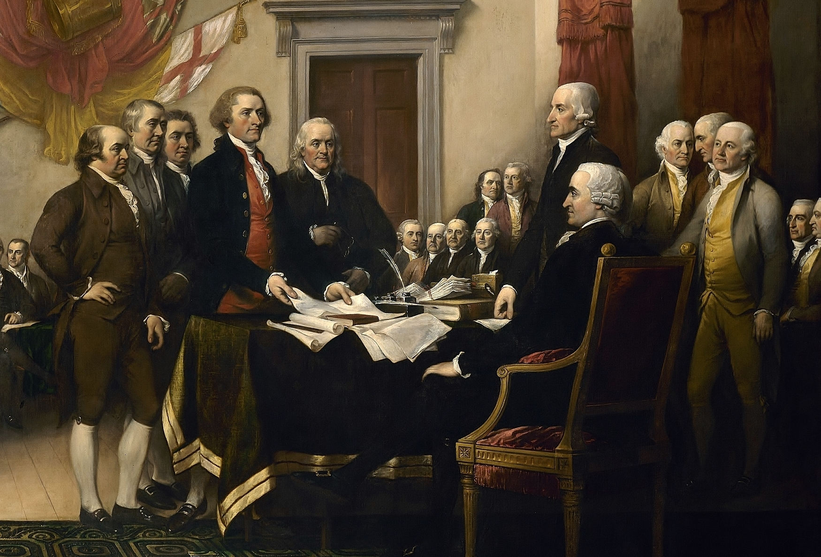
Mr. Hancock...if you please...

Slide 28
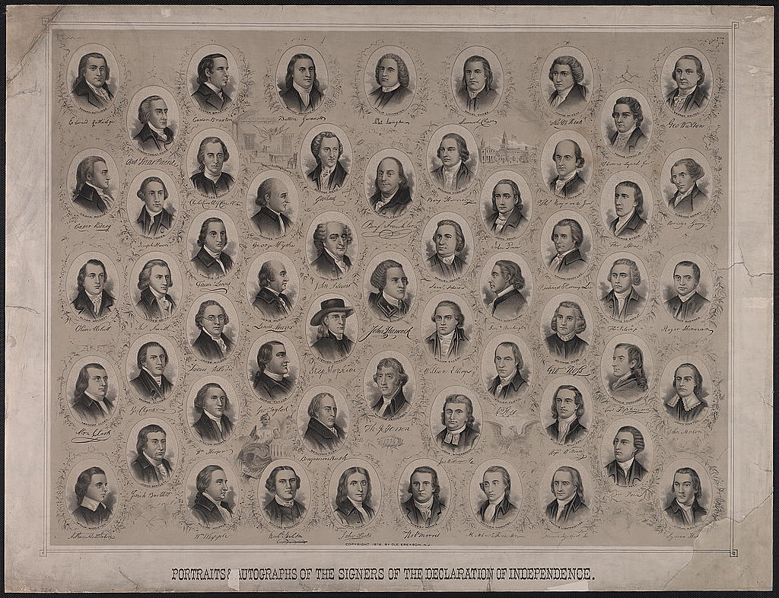
We have thus declared with a mutual pledge
that our homeland shall be free!

Slide 29
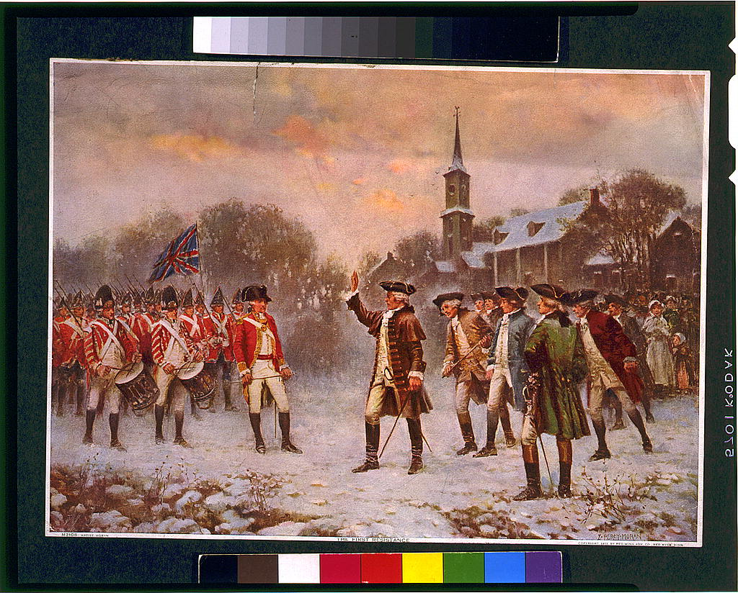
That we who dwell herein, shall be counted in
choosing life and liberty!

Slide 30
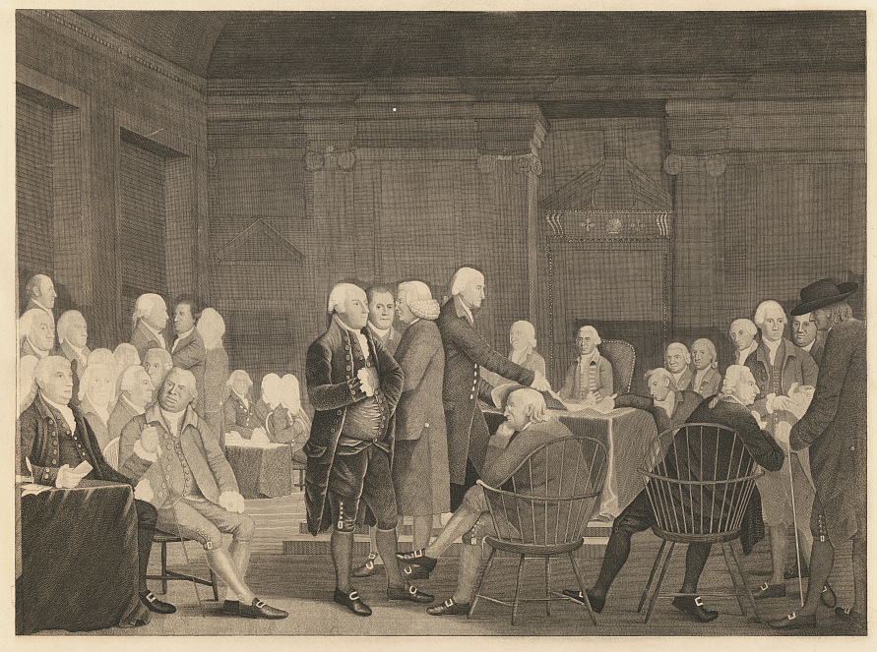
We shall raise our voice with pure intent to declare:
WE SHALL BE FREE!

Slide 31
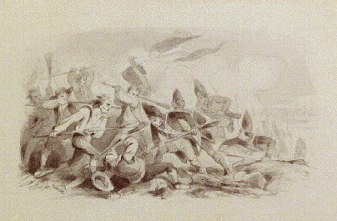
The war has begun, and our noble sons
heed the call to join the fight -

Slide 32
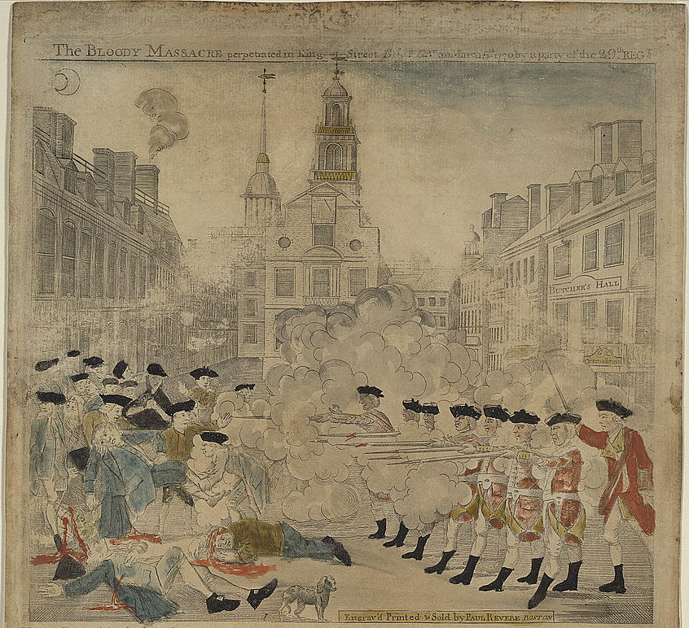
We know the odds aren't fair and the foe is cruel -

Slide 33
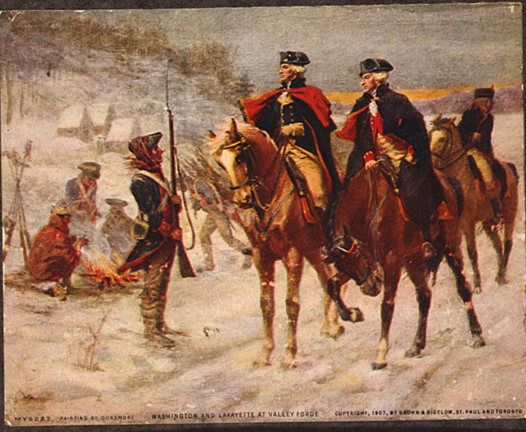
Yet they stay the course in spite!

Slide 34
Fighting for the right that we here might
have the freedom to self-rule

Slide 35
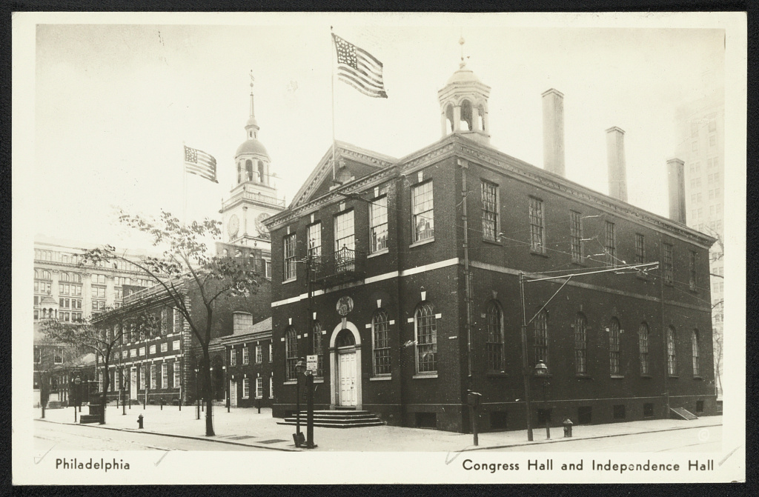

Slide 36
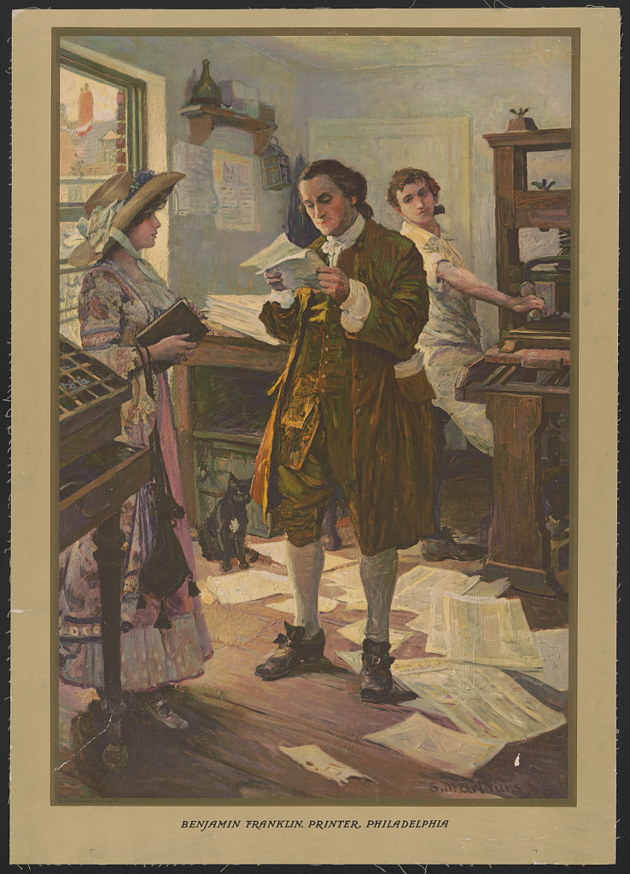
Freedom of the press, speech and assembly -

Slide 37
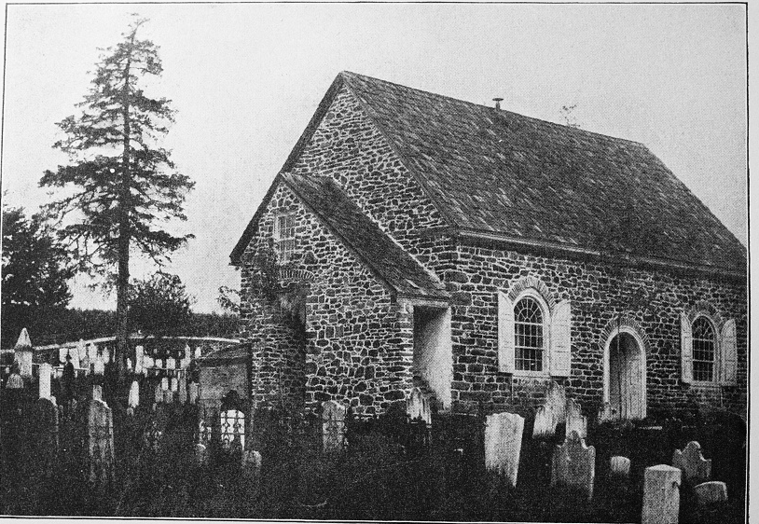
Episcopal Church in Valley Forge
And we're free to worship as we please​

Slide 38
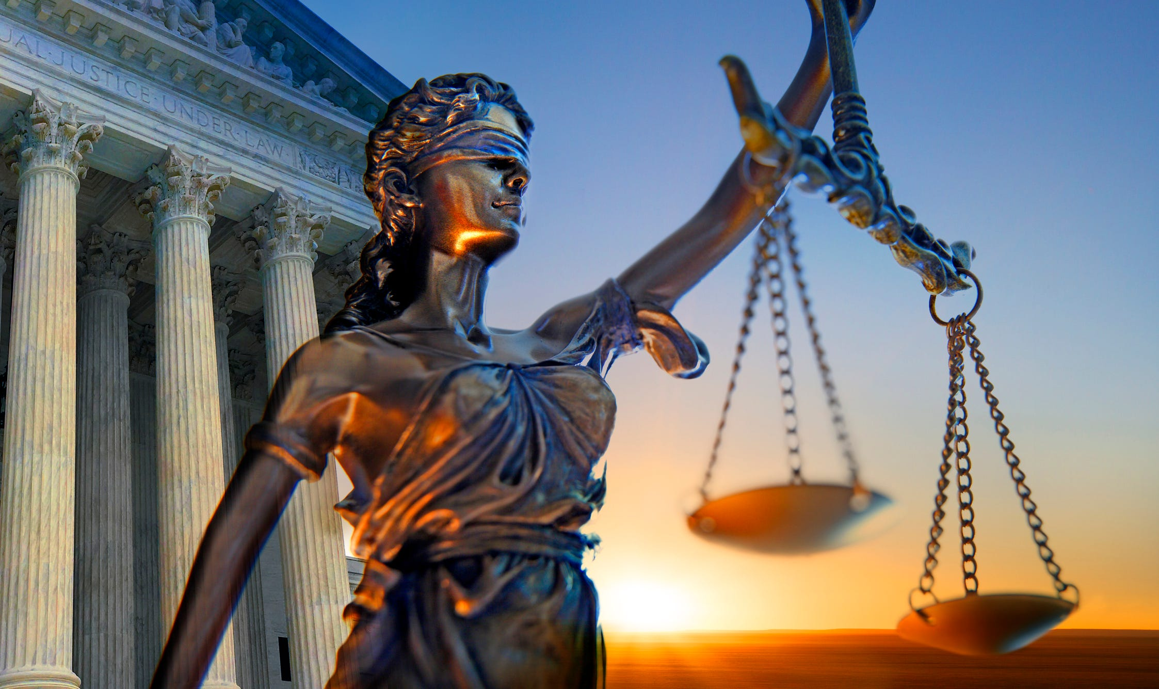
A fair trial and the right to vote

Slide 39
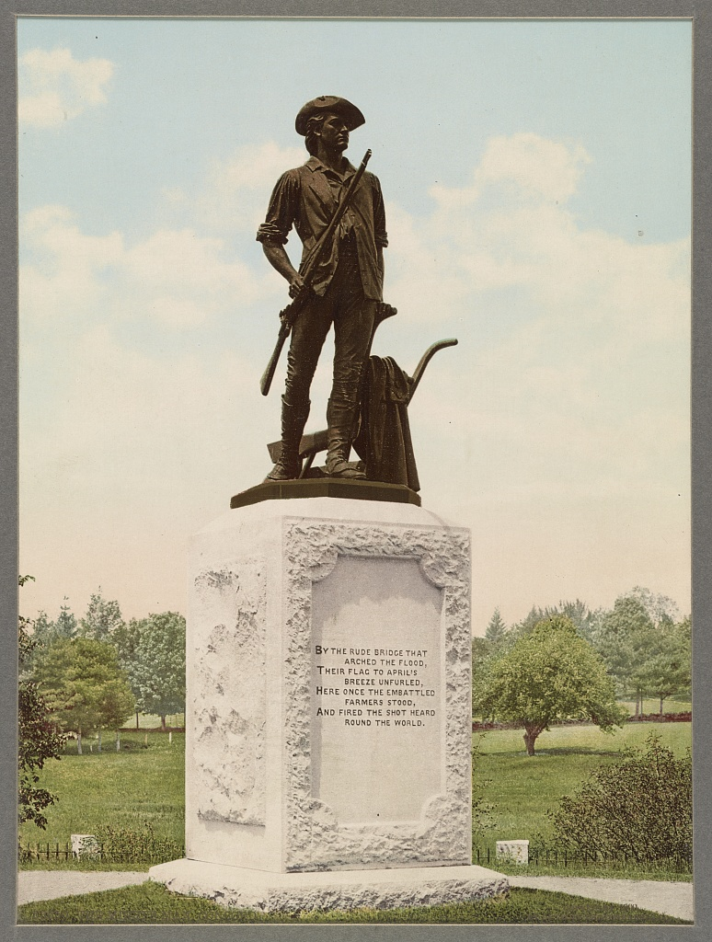
Honoring the Minutemen
Will be hard won guarantees...

Slide 40
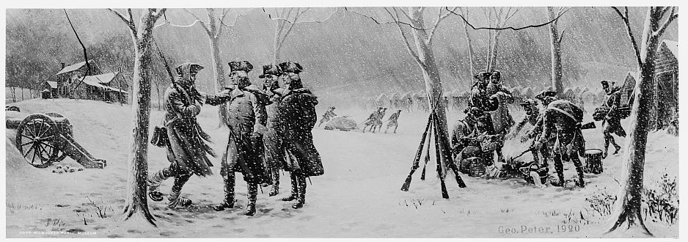
We remember their brave sacrifice...

Slide 41
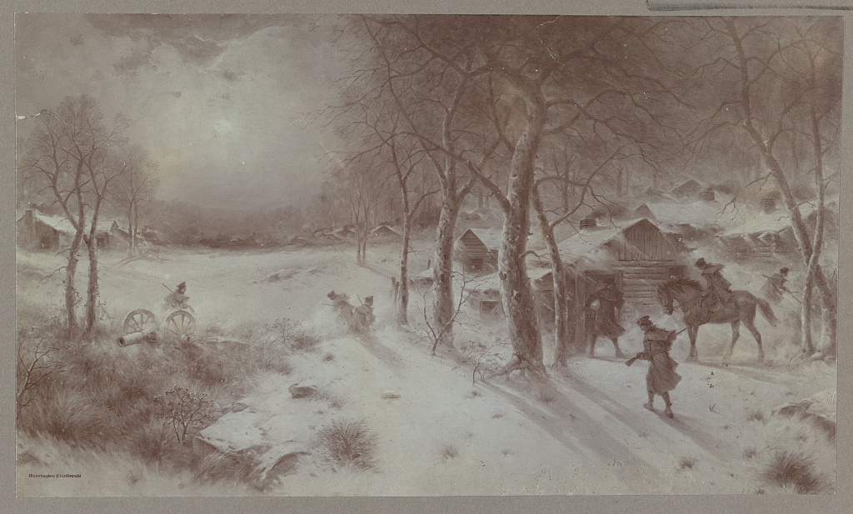
(Return of the Scout to Valley Forge)
We know freedom is... not... free

Slide 42
For each of us must take part,
vote the will of our hearts
for our nation's sovereignty!

Slide 43
We declare... we are free...
independent of... any other sovereignty

Slide 44
And we know that the fight for what is right...

Slide 45
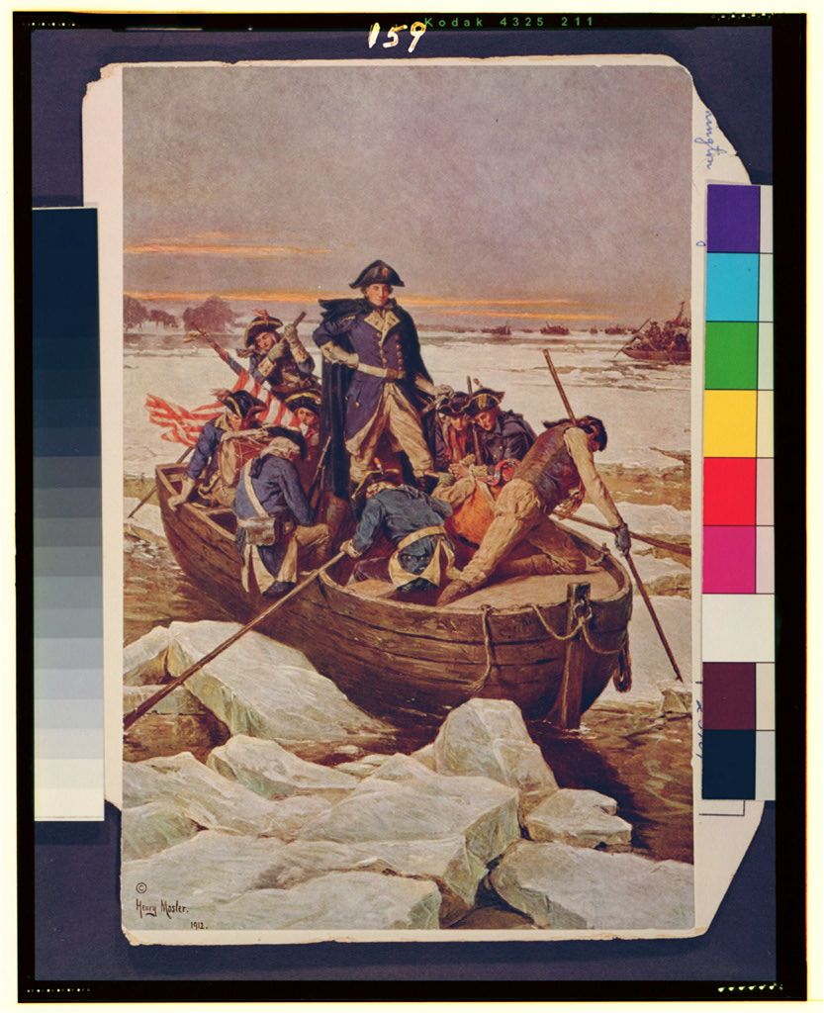
will be difficult,

Slide 46
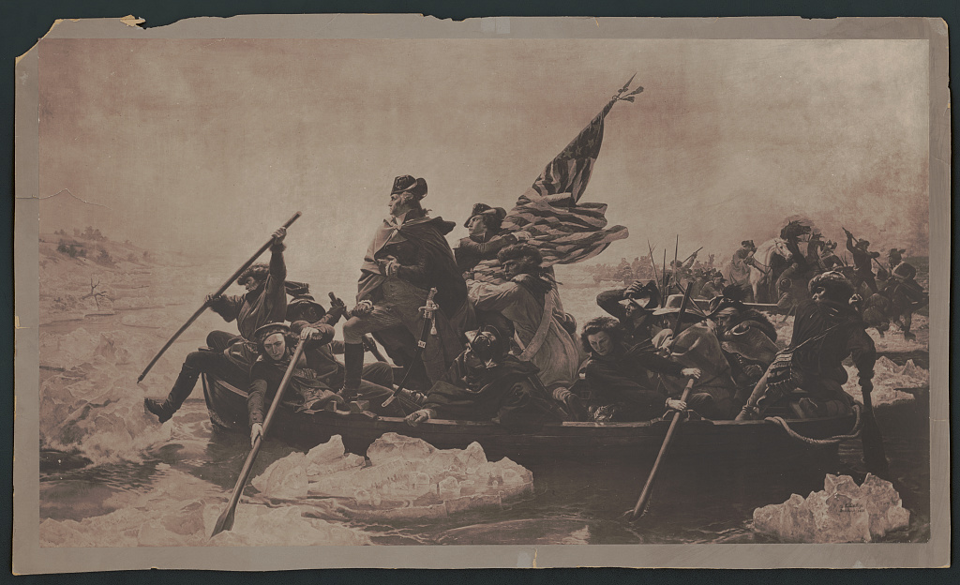
will be challenging,

Slide 47
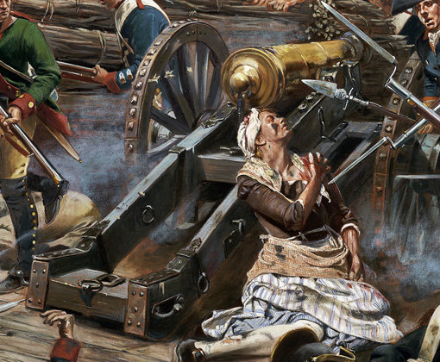
will be hard fought

Slide 48
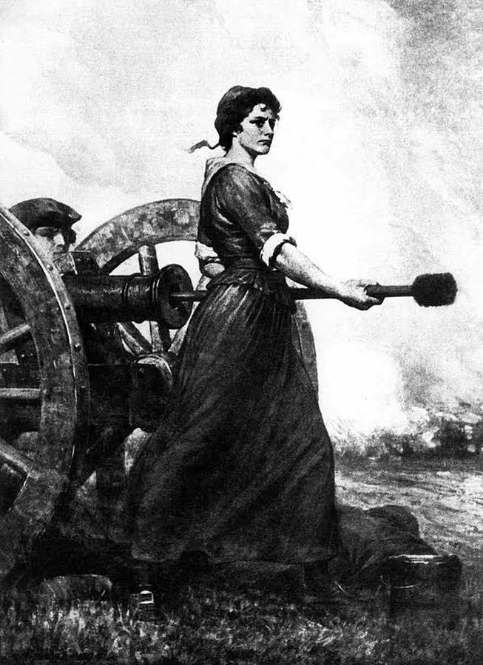
(Captain)
Margaret Corbin
for democracy...

Slide 49
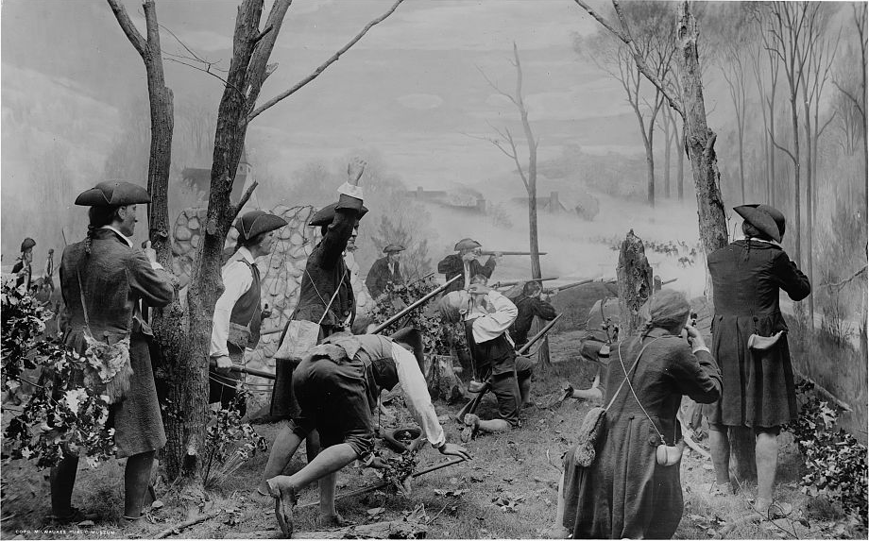
BUT NO ONE SHALL DOUBT

Slide 50
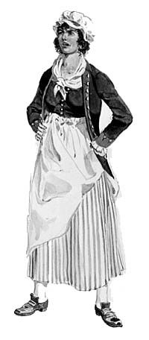
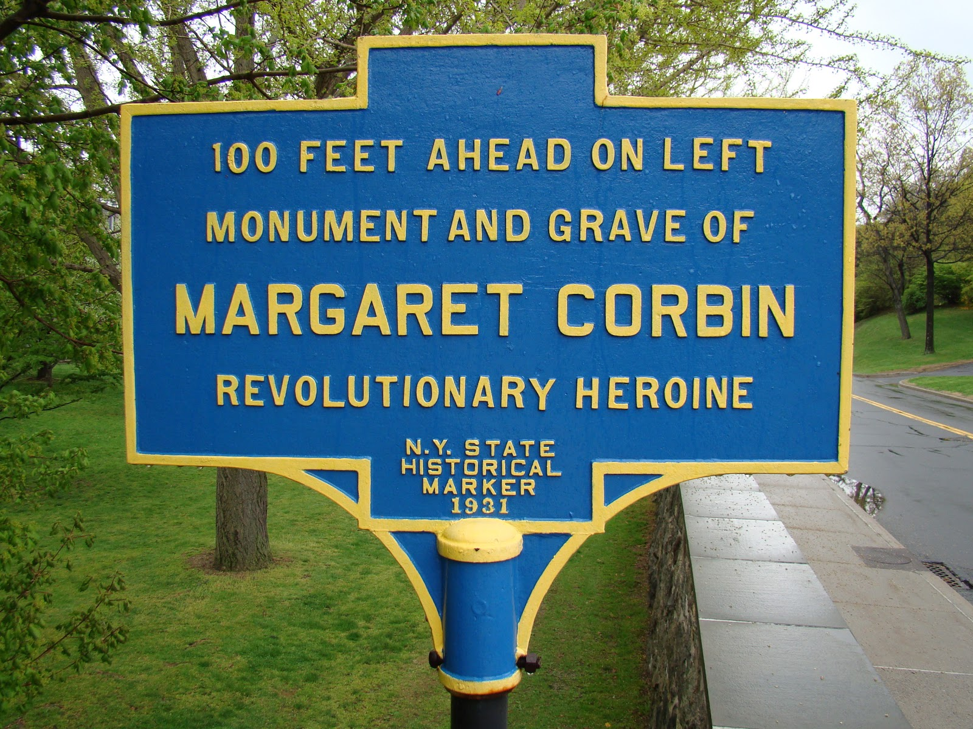
OUR RESOLVE TO WIN

Slide 51
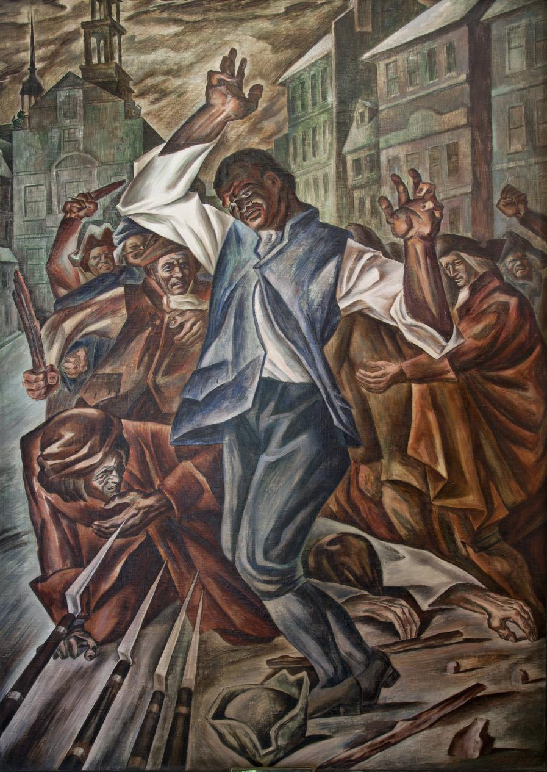
Crispus Attucks
INDEPENDENCE

Slide 52
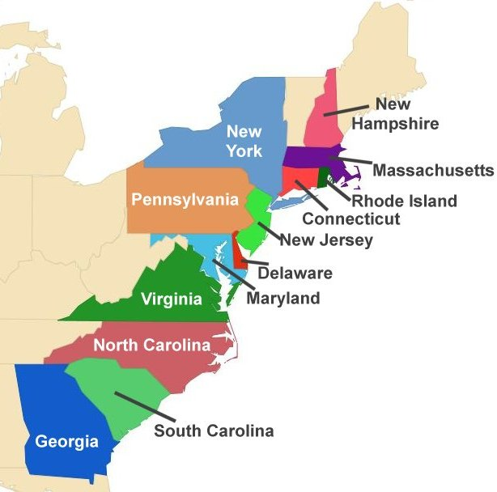
For these UNITED STATES!

Slide 53
WE DECLARE INDEPENDENCE!

Slide 54
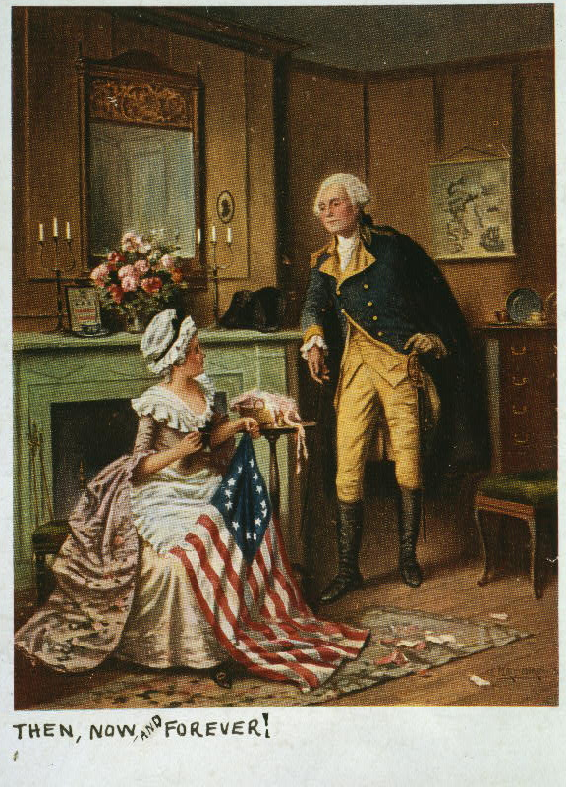
WE DECLARE INDEPENDENCE!

Slide 56
We Declare Independence!
Music, Lyrics, and Narrative Text by Scott Freeby
Images are courtesy of the Library of Congress
Commissioned by the Kansas Music Educators Association
For the Celebration of the 250th Anniversary of the signing of the
Declaration of Independence
July 4, 1776 to July 4, 2026

Slide 58
Credits:
Narrative text compiled from the words found in the Declaration of Independence, The Bill of Rights, and the Constitution of the United States of America
Currier & Ives. The Declaration committee. United States, 1876. [New York: Published by Currier &
Ives, 125 Nassau St., New York] Photograph. https://www.loc.gov/item/91795008/.
3. N. Currier. Destruction of tea at Boston Harbor. , 1846. [New York: N. Currier] Photograph.
https://www.loc.gov/item/91795889/.
4. Philadelphia. Independence Hall. Pennsylvania Philadelphia United States, 1936. Photograph.
https://www.loc.gov/item/2024692653/.
5. Basset, André, Active , Publisher. La destruction de la statue royale a Nouvelle Yorck Die zerstorung der
koniglichen bild saule zu Neu Yorck. New York United States, . [Paris: Chez Basset, Rue St. Jacques,
177] Photograph. https://www.loc.gov/item/2004670213/.
6. Pollard, Robert, Engraver, and Joshua Reynolds. George III, King of Great Britain &c / Pollard sculp. United States,
1782. [Newcastle upon Tyne: Printed for T. Robson] Photograph. https://www.loc.gov/item/2003675475/.

Slide 59
Credits:
7. Philadelphia. Independence Hall Judicial Chamber. United States Philadelphia Pennsylvania, 1936.
Photograph. https://www.loc.gov/item/2024692643/.
8. Jefferson, Thomas, Author, and United States Creator Second Continental Congress. Engrossed Declaration of
Independence. [Place of Publication Not Identified: Publisher Not Identified, -08-02, 1776] Pdf.
https://www.loc.gov/item/2021667571/.
9. Dunlap, John, Printer, Thomas Jefferson, and United States Creator Second Continental Congress. Dunlap
Broadside Declaration of Independence. Philadelphia, Pennsylvania: John Dunlap, -07-04, 1776. Image.
https://www.loc.gov/item/2021667578/.
10. Benjamin Franklin signing the Declaration of Independence. , ca. 1911. Photograph.
https://www.loc.gov/item/96508610/.
11. Trumbull, John, Artist, Copyright Claimant Detroit Publishing Co, and Publisher Detroit Publishing Co.
Declaration of Independence. Pennsylvania Philadelphia United States, None. [C between 1900 and 1912]
Photograph. https://www.loc.gov/item/2016817173/.

Slide 60
Credits:
12. Ibid
13. Erekson, Ole , Lithographer. Portraits & autographs of the signers of the Declaration of Independence. , ca.
1876. Photograph. https://www.loc.gov/item/2003666901/.
14. Moran, Percy, Artist. The first resistance / E. Percy Moran. United States, ca. 1911. Photograph.
https://www.loc.gov/item/96516286/.
15. Savage, Edward, Engraver, and Robert Edge Pine. Congress voting the Declaration of Independence. United
States, 1800. [Boston: between ? and 1900?] Photograph. https://www.loc.gov/item/2008678323/.
16. Darley, Felix Octavius Carr, Artist. Revolutionary War battle between civilians and British soldiers. United
States, None. [Between 1840 and 1888] Photograph. https://www.loc.gov/item/2010715550/.
17. Revere, Paul, Engraver. The bloody massacre perpetrated in King Street Boston on March 5thby a party of the
29th Regt. Boston Massachusetts, 1770. Boston: Engrav'd Printed & Sold by Paul Revere. Photograph.
https://www.loc.gov/item/2008661777/.
18. Dunsmore, John Ward, Artist. Washington and Lafayette at Valley Forge / painting by Dunsmore. Pennsylvania
United States Valley Forge, ca. 1907. Photograph. https://www.loc.gov/item/91792202/.

Slide 61
Credits:
19. Congress Hall and Independence Hall. United States Philadelphia Pennsylvania, 1936. Photograph.
https://www.loc.gov/item/2024692654/.
20. Benjamin Franklin, printer, Philadelphia. , ca. 1914. [Philadelphia: publisher not transcribed] Photograph.
https://www.loc.gov/item/2018697087/.
21. St. Davids Episcopal Church in Valley Forge. Library of Congress Prints and Photographs Division Washington,
D.C. 20540 USA http://hdl.loc.gov/loc.pnp/pp.print https://www.loc.gov/pictures/item/pa0444/
22. Royalty Free Clip Art. Justice is Blind
23. Detroit Publishing Co., Publisher, and Copyright Claimant Detroit Publishing Co. The Minute Man, Concord.
Concord United States Massachusetts, ca. 1900. Photograph. https://www.loc.gov/item/2016794229/.
24. Peter, George, Artist, Publisher Detroit Publishing Co, and Copyright Claimant Milwaukee Public
Museum. Soldiers standing in snow-covered military camp, possibly in Valley Forge, Pa., during American
Revolution. Valley Forge Pennsylvania United States, ca. 1920. [C] Photograph.
https://www.loc.gov/item/2016816528/.

Slide 62
Credits:
25. Fitzgerald, Harrington, Artist. Return of the scout to Valley Forge. United States Pennsylvania Valley Forge, ca.
1880. [Between and Ca. 1910] Photograph. https://www.loc.gov/item/2018654945/.
26. Leutze, Emanuel, Artist. George Washington crossing the Delaware River. Delaware River New York United
States Trenton New Jersey Delaware, ca. 1912. , C1913. Photograph. https://www.loc.gov/item/93504010/.
27. Leutze, Emanuel, Artist. Washington Crossing the Delaware. United States New York Delaware New Jersey
Trenton Delaware River, ca. 1857. Photograph. https://www.loc.gov/item/2006677794/.
28. Margaret Cochran Corbin: Detail from "Captain Molly."
Irish American Heritage Month: Margaret Corbin, “Captain Molly”
29. (Capt.) Margaret Corbin
30. Detroit Publishing Co., Publisher, and Copyright Claimant Milwaukee Public Museum. Colonial soldiers
engaged in battle in a forest, possibly during the American Revolution. , None. [Cbetween 1900 and 1920]
Photograph. https://www.loc.gov/item/2016816527/.
31. https://sl.bing.net/uOX1pwyIPk Molly Pitcher (Molly Hays on the Battle Field)

Slide 63
Credits:
32. Highsmith, Carol M, photographer. "Crispus Attucks," by Herschel Levit, mural at the Recorder of Deeds
building, built in . 515 D St., NW, Washington, D.C. Washington D.C. Washington D.C. United States District of
Columbia, 2010. Photograph. https://www.loc.gov/item/2010641712/.
33. Us Map 13 Colonies - Winna Kamillah
34. Moran, Percy, Artist. Then, now, and forever! / E. Percy Moran. , ca. 1908. Photograph.
https://www.loc.gov/item/94507641/.

